Slide 1

CHAPTER 4: PREPARING THE PLAN

Slide 2

CONTENTS:
Preparing the Plan:
Understanding Planning: Definitions, Types and Strategies.
Gathering user data.
Outlining strategies.
Estimated budget.

Slide 3

Definition of Planning
Define as ‘an analytical process which involves an assessment of the futures, the determination of desired objectives in the context of that future, the development of alternative courses of action to achieve such objectives and the selection of a course, or courses of action from among these alternatives.’

Slide 4
Planning also define as:
Planning is a philosophy (a set of belief based on knowledge). It represents an organization approach to decision making.
Planning is a process. It is a continuous activity and involves ongoing commitment of staff, resources, and administrators.
Planning is actually an amalgam (mixture / blend) of mini plans, interrelated at several levels.

Slide 5

Why planning? (The purposes/reasons)
1. Boasting Output
2. Growth and Survival
3. Offsetting Uncertainty
4. Preparing for & Adapting to Change
5. Focus Attention On a Clear Direction
6. Facilitate Control

Slide 6
Benefits of planning
1. Clarity of Objectives
2. Resource Allocation
3. Targeted Approach
4. Performance assessment and Evaluation
5. Enhanced Coordination

Slide 7
Strategy Planning and Implementation
Identify the community
Identify one or more community partners who can facilitate experiences for students aligned with the desired learning outcomes.
Identify
Identify the suitable type of SULAM@UiTM project for the course.
Meeting with the community
Arrange a face-to-face meeting with the community to discuss the objectives and desired outcomes of the planned project..
Contact
Contact relevant organizations to obtain additional information for assessing the suitability of the community partnerships.
Implementation
Develop a comprehensive reflection activity for assessing and developing students in alignment with the desired learning outcomes.
Design an assessment process and strategy for enhancing collaboration among students, the community, and industry.
Preparation
Prepare a risk action plan related.

Slide 8
Types of planning
1. Management by objective (MBO) / Strategic Plans
2. Single use plans
3. Standing plans
4. Contingency plans

Slide 9
Definition: As an essential philosophy of management based on identifying purpose, objectives, strategy, and desired results, and evaluating performance in achieving them (Migliore & Gunn, 2010)
Management by objective (MBO) / Strategic Plans

Slide 10
4 MAJOR ACTIVITIES involves: 1. Setting goals 2. Develop action plans 3. Review progress 4. Appraise overall performance
Management by objective (MBO) / Strategic Plans

Slide 11
4 MAJOR ACTIVITIES involves: 1. Setting goals ~ Decide on the objective of the extension. ~ Evaluate the factors that may influence on the objective. Eg. SWOT Analysis
Management by objective (MBO) / Strategic Plans

Slide 12
4 MAJOR ACTIVITIES involves: 2. Develop action plans ~ The action plan comprise of activity to break down the strategic plan into a more individual tactical plan so that it will be easier to monitor and to execute the work. ~ The action plan should coincide with the overall organizational mission and objective.
Management by objective (MBO) / Strategic Plans

Slide 13
2. Develop action plans Example of an Action plans
Project/Activities | Objective | Strategy | Responsibility | Timeline
Name of specific extension service or activity | What to be achieve and why | The processes needed to achieve the objective and how to execute it | Who is going to accomplish that objective (the executor and also the supervisor) | The specific timeframe to accomplish the objective

Slide 14
4 MAJOR ACTIVITIES involves: 3. Review progress ~ The progress of the executed plan must be recorded so that it can be reviewed according to the specified period stated. ~ A date and period of reviewing the progress must be decided and adhere.
Management by objective (MBO) / Strategic Plans

Slide 15
3. Review progress Among things need to be monitored are:
Activities still conforms and follows the parameters agreed and decided in the strategic aims and objectives;
Ensuring the activities consistent with mission and vision of the organization;
Keep under review internal and external changes which may require changes to strategy that may affect the ability to achieve objectives.

Slide 16
4 MAJOR ACTIVITIES involves: 4. Appraise overall performance ~ At the end of the strategic plan implementation, you will have the end results of all the activities executed.
Management by objective (MBO) / Strategic Plans

Slide 17
4. Appraise overall performance What needed to be assessed at the end of the plan :
Did the programs and activities implemented as planned and reach its stated objective?
What are the issues impeded or facilitate the execution of the programs successfully?
What is the level of success or failure in terms of implementation and the target audience acceptance
What need to be change for the next strategic plan in term of ensuring a much better or continuous success of the programs and activities.

Slide 18
Definition: Referred to as ‘specific plans’ since these are meant to solve a particular problem. These plans are formulated to handle non-repetitive and unique problem. These plans cannot be used again and again; these become obsolete after achieving their purpose. E.g.: projects, budgets, programs.
Single use plans

Slide 19
Definition: Also called ‘repeated use’ plans, are plans made to be used time and again. These plans are formulated to guide managerial decisions and actions on problems which are recurring in nature. It provide guidelines for actions to be taken in future. Examples: objectives policies, procedures, methods, rules and strategies.
Standing plans

Slide 20
Definition: This isn't just about major crises and natural disasters. It can also prepare plans for more commonplace problems, such as the loss of data, staff, customers, or business relationships. That's why it's important to make contingency planning a routine part of the way you work.
Contingency plans

Slide 21

STEP ONE
1. DEVELOP STRATEGIES
Environmental Assessment - Research
and Analysis.
STEPS IN PLANNING AN OUTREACH PROGRAM
.
Determine purpose of event – should be
measurable.
01
3. Match selected event with purpose.
4. Determine special group stakeholder.
5. Ensure enough manpower supports.
6. Ensure enough time for planning.
7. Find way to evaluate success of event.

Slide 22
STEP TWO
2. DEVELOP A CHECKLIST
Create a step-by-step guide to organize and execute an event.
STEPS IN PLANNING AN OUTREACH PROGRAM
.
A time line would be helpful.
Example: Gantt Chart
02

Slide 23

STEP THREE
3. CREATE THE BUDGET
Should be specific – the usage or purpose.
STEPS IN PLANNING AN OUTREACH PROGRAM
.
Include pre-event expenses such as printing, postage, permits and others.
(Example: speakers, food, supplies,
security, transportation, lodging.)
03
Include also revenue opportunities
(if any)
.

Slide 24
STEP FOUR
4. LOOK FOR SPONSOR OR PARTNERS
Consideration to win-win situation with sponsors.
STEPS IN PLANNING AN OUTREACH PROGRAM
.
Normally business / corporations.
04
Consider also compatibility issue.

Slide 25
STEP FIVE
5. LOGISTIC
Space(s) – appropriate and with minimal obstacles.
STEPS IN PLANNING AN OUTREACH PROGRAM
Adequate utility support – electricity, water, lighting, telephone line, LAN, etc.
05
Furniture and fittings - table, chairs, signage, exit, entrance, information kiosk, etc.
4. Public sectors – fire department, medical.
Event schedule – made known to all
parties involved.
6. Transportation – vehicle, parking, accessibility.

Slide 26

STEP SIX
6. PLAN FOR PUBLICITY
STEPS IN PLANNING AN OUTREACH PROGRAM
Consider right publicity vehicle with event.
Organize list of special guests or VIPs.
06
Choose suitable media plan to effectively reaching and engaging the target audience :
print media
radio
website
television
mail
special items ( posters, flyers, stickers, bookmark, etc.)

Slide 27
STEP SEVEN
7. EVALUATE THE EVENT
Evaluate the strategies, checklist, budget,
sponsors, logistic, and effectiveness.
STEPS IN PLANNING AN OUTREACH PROGRAM
Evaluate the objective – fulfilled?.
Evaluate elements that worked and those that failed.
07
4. Evaluate missed opportunities.
Evaluate time and money spent by every parties involved.

Slide 28

Gathering User Data
1. Gathering user data in a community outreach program involves collecting information about the individuals or groups within the target community to better understand their:
needs,
preferences,
behaviors, and
demographics.
2. This data serves as a foundation for designing and implementing effective outreach initiatives that resonate with the community and address its specific challenges and opportunities.

Slide 29





Outlining strategies to gather user data
2. Data Collection Methods
4. Use of Data for Program Improvement
5. Measuring Impact
6. Data Privacy and Security
Identification
of Target Audience
3. Data Analysis
Surveys Interviews, Observations, Social Media Monitoring, Feedback Forms, Registration Forms.
Analyzed the Collected data.
Key performance indicators (KPIs) to assess the effectiveness of the program.
Obtaining consent for data collection, protecting sensitive information, and using data only for its intended purpose.
Demographics, interests, geographical locations..
To improve the outreach program.
e.g.: Targeting different demographics, offering new services, changing the approach based on feedback.
www.free-powerpoint-templates-design.com

Slide 30

Participatory design
One of the methods for gathering user data or seeking specific feedback or community engagement.
The focus of this participatory design is to ensure users have an equal voice in the process of creation so that library or other information agencies employees are working alongside stakeholders to develop a plan that will ultimately help both sides fulfil their roles and define success.
Example of participatory design: 1. focus groups, 2. co-design workshops, and 3. community forums to ensure that their voices are heard and valued.

Slide 31
Participatory design
4. The three (3) participatory design are:
1. Ethnographic approaches
2. User experience approaches
3. Equity-centered design

Slide 32
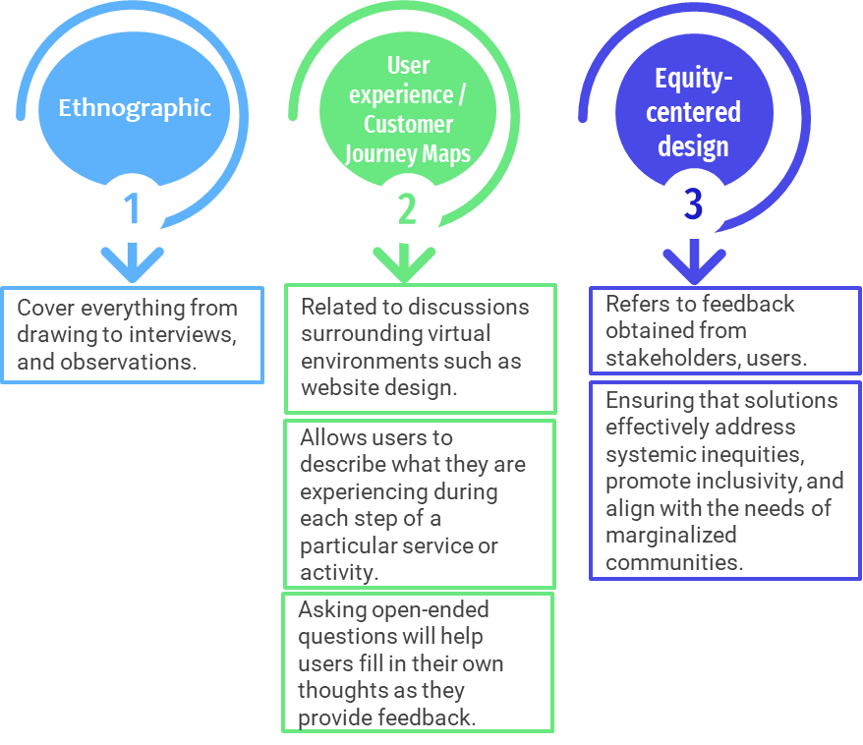
Participatory design

Slide 33
Estimated budget
1. A budget is defined as a financial plan that outlines expected income and expenses over a specific period, typically for a project, organization, or individual. It serves as a roadmap for managing financial resources effectively, allocating funds to various activities, and achieving financial goals.
2. Budgeting for an outreach program in information agencies involves allocating financial resources to activities aimed at disseminating information, engaging stakeholders, and promoting the agency's services or resources.
3. Effectively allocating resources is crucial for the success of outreach programs in information agencies and to maximize the impact of the outreach initiatives.

Slide 34
Estimated budget
4. Objectives of budget:
a) Budgets provide a structured framework for planning and managing
financial resources effectively,
b) To assist in allocating resources,
c) To assist in controlling and monitoring resources utilization during the
budget period.
5. There are two types of budgets:
i. Activity Budget and
ii. Line-Item Budget.

Slide 35
1. Activity Budget
1. Activity budget, as the name suggests, covers the costs required for implementing a project activity.
2. The budget includes various expenses such as materials and supplies, technology and equipment, transportation, staffing, promotion and advertising, and miscellaneous expenses.
3. For example, if your outreach program is about Dewey Decimal Classification Workshop aimed at teaching library prefects about library organization and classification systems, you need to break up each and every expense as given below. Here are the estimated budget:

Slide 36
Activity: Dewey Decimal Classification Workshop
1. Materials and Supplies:
Printing of Dewey Decimal Classification Handouts: RM 50
Purchase of Reference Books for Practical Exercises: RM 100
2. Technology and Equipment:
Projector Rental: RM 50 (if necessary, otherwise use existing equipment)
3. Transportation:
Travel Allowance for Facilitators: RM 50 or No transportation costs (if the venue is on campus)
4. Staffing:
Honorarium for Guest Instructor: RM 150
Volunteer Coordinator (student organizer): No allowance
5. Promotion and Advertising:
Printing of Flyers and Posters: RM 50
Social Media Promotion: No cost (utilize existing platforms and networks)
6. Miscellaneous Expenses:
Refreshments for Participants: RM 100 (simple snacks and drinks)
Contingency Fund: RM 50
Total Budget for Dewey Decimal Classification Workshop: RM XX

Slide 37
2. Line-Item Budget
1. Divides objects of expenditure into broad input classes or categories or line items, such as materials and supplies, transportation, staffing, promotion and advertising, etc. with further subdivisions within those categories.
2. Each line item represents a distinct expense associated with the project, allowing for transparent and comprehensive financial planning.
3. A Line-Item budget can be known under different names, but they can be quite complicated, unlike an Activity budget.

Slide 38

Conclusion
Having plans is essential for achieving goals, making effective use of resources, and ensuring that everyone is working towards a common purpose. It provides direction, sets priorities, facilitates decision-making, improves coordination, and provides a basis for monitoring and evaluation.

Slide 39



Exercise
Tutorial Task: Budgeting for an Outreach Program
List Potential Expenses: Students need to brainstorming potential expenses associated with your outreach program. Kindly consider categories such as materials and supplies, transportation, staffing, promotion, and miscellaneous expenses.
Create a Budget Spreadsheet: Create a budget spreadsheet or use a budgeting template to organize your expense allocations.

Slide 40

THANK YOU!

